Slide 1
Diet Related Disorders

Slide 2
The major causes of death in Australia are linked to diet and lifestyle. Some people consume a well-balanced diet while others do not.
Poor nutrition and an unhealthy lifestyle are related to many disorders.
Making the right food choices can significantly reduce the risk of developing diet-related disorders.

Slide 3
What are diet related disorders?
Malnutrition refers to an imbalance of nutrients. It can result from either consuming too many nutrients (overnutrition) or not consuming enough nutrients (undernutrition). In both cases, the balance of nutrients is not correct. Not enough or too many nutrients can result in diet-related diseases

Slide 4
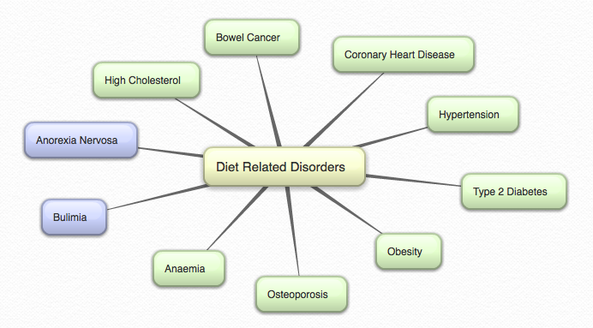

Slide 5
Anaemia
Anaemia is a blood condition and is the most common deficiency disease in Australia, particularly in females.
It is caused by a prolonged iron deficiency.
Estimates suggest that around one in five menstruating women and half of pregnant women are anemic.
Symptoms of anaemia include irritability, faintness and fatigue. This means that the body is not able to operate normally.
The lack of iron is a common nutrient deficiency in many developed countries.

Slide 6
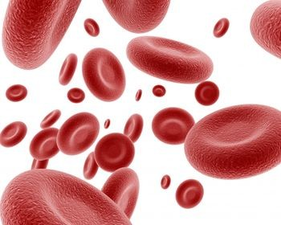
Anemia (continued)
Symptoms of iron deficiency include:
Weakness
Tiredness
Decreased ability to maintain a constant body temperature
Decreased ability to perform physical activity.

Slide 7
Anorexia Nervosa
Anorexia nervosa is a psychological condition in which a person refuses to eat sufficient food to maintain a minimum normal weight for age and height. It may also include exercising excessively.
This has serious effects on many body systems and may result in death.
This disorder occurs most often in young women, aged from the late teens to the mid twenties.
- Can you think of any positive body image campaigns?

Slide 8
Bulimia
Bulimia is an eating disorder marked by cycles of binge eating of excessive quantities of food, followed by purging through vomiting or use of laxatives.
The purging can seriously damage health.
Unlike anorexia, a person with bulimia is rarely underweight.

Slide 9
Bowel Cancer
The bowel in the body includes the small bowel, colon and rectum, and consists of the long tube that absorbs water and nutrients from food and processes waste products into faeces.
Bowel (or colorectal) cancer usually begins in the lining of the colon or rectum. If left untreated, the cancer will spread into the wall of the bowel, then possibly the liver and lungs.
Bowel cancer is a common illness in Australia, with over 12 500 people being diagnosed every year.

Slide 10
Bowel Cancer (continued)
Factors that are considered risk factors for bowel cancer include:
High intake of saturated fat
High intake of salt
Low intake of fibre
Lack of physical activity.
These factors can be prevented with changes to eating and physical activity behaviours.

Slide 11
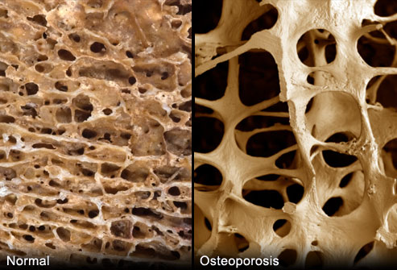
Osteoporosis
Osteoporosis is a condition in which the loss of bone density mass results in brittle bones.
This means that the bones become thinner, more porous and therefore more liable to break.
Osteoporosis is linked to a lack of calcium. It is therefore important to build up bone density by consuming calcium-rich foods such as dairy products, during childhood, adolescence and early adulthood.

Slide 12
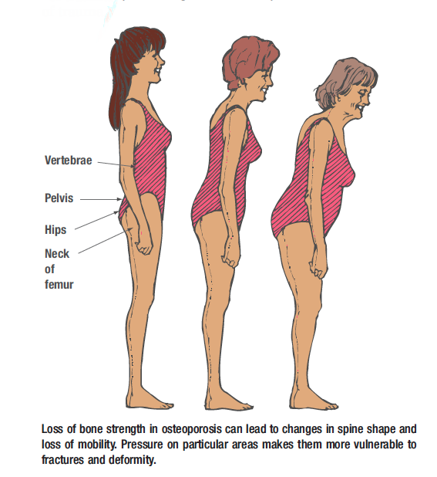
Osteoporosis (continued)

Slide 13
Obesity
Obesity is a very serious problem in Australia – approximately two-thirds of the adult population are overweight and 20% are classified as obese.
Too much food and too little physical exercise result in an increase in weight.
Obese people are those who are 20% or more above their recommended weight for height.
People who are obese are also at a higher risk of developing other diet related disorders.
Brooklyn Burger Joint Brings Back The Donut Burger - The 100 percent Angus beef burger, topped with American cheese, bacon and a fried egg, is served on a glazed doughnut

Slide 14
Type 2 Diabetes
Diabetes occurs when the body cannot make proper use of the glucose in the blood.
Type 2 diabetes accounts for 90% of all diabetes cases and is diet related.
Insulin is manufactured by the body to move glucose into the cells. When the body resists the action of the insulin, the glucose cannot enter the body’s cells.
This resistance occurs because of the increasing levels of fat in and around the cells, most often seen in overweight or obese people.

Slide 15
Type 2 Diabetes (continued)
When the insulin cannot get the glucose into the cells, the body responds by producing more insulin. If this continues over a long period of time, type 2 diabetes may develop.
In many cases, being overweight or obese results in high insulin levels and insulin resistance.
What is the difference between type 1 and type 2 diabetes?

Slide 16
Hypertension
Also known as high blood pressure
Too much sodium in the diet is a major contributing factor.
When there is too much sodium, the body retains water and the heart has to work harder to pump the blood under increased pressure.
This means that blood circulation is less efficient, and the arteries become less elastic.

Slide 17
Coronary Heart Disease
Coronary heart disease kills one in three adult Australians and is the leading cause of death in Australia.
It occurs when the arteries in the heart become clogged with fatty deposits that restrict the amount of blood that can be pumped through them – sometimes they even become totally blocked.
This makes the heart work harder to pump blood around the body and places extra pressure on the heart.

Slide 18
High Cholesterol

Slide 19
High Cholesterol
Cholesterol is an important part of cell membranes and some hormones.
It is also an essential substance for good health.
We do not need to consume it as our body can make its own supplies.
Problems arise therefore with cholesterol when people consume too much saturated fat.
Clogged arteries make blood flow hard and enable blood clots to settle.

Slide 20
High Cholesterol (continued)
To decrease blood cholesterol, one must decrease saturated fats in the diet. Oats, legumes and some fruits and vegetables, all high in soluble fibre, tend to increase the amount of cholesterol that is excreted from the body.

