Slide 1
What are our preferred learning styles?

Slide 2
Activity: Think, Pair, Share
How do you like to learn?
What are some activities that you learn best from in class? – List 3
Why do you think we all learn differently?

Slide 3
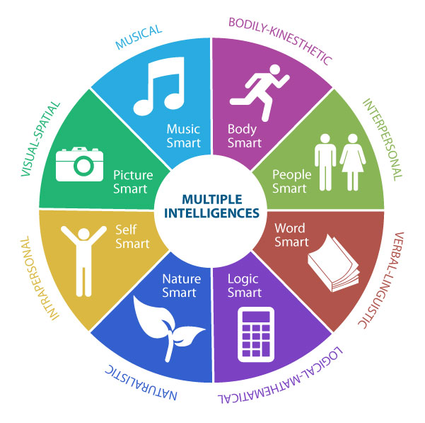

Slide 4
Verbal - Linguistic
Strengths: Words, Language and Writing
People who are strong in linguistic-verbal intelligence are able to use words well, both when writing and speaking. These individuals are typically very good at writing stories, memorizing information and reading.
Characteristics of Linguistic-Verbal Intelligence
Good at remembering written and spoken information
Enjoys reading and writing
Good at debating or giving persuasive speeches
Able to explain things well
Often uses humor when telling stories

Slide 5
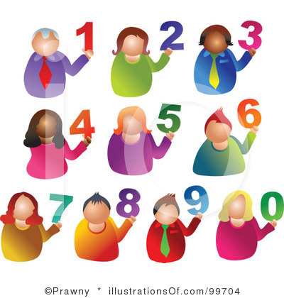
Logical - Mathematical
Strengths: Analysing Problems and Mathematical Operations
People who are strong in logical-mathematical intelligence are good at reasoning, recognizing patterns and logically analyse problems. These individuals tend to think about numbers, relationships and patterns.
Characteristics of Logical-Mathematical Intelligence
Excellent problem-solving skills
Enjoys thinking about abstract ideas
Likes conducting scientific experiments
Good and solving complex computations

Slide 6
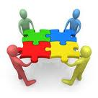
Interpersonal
Strengths: Understanding and Relating to Other People
Those who have strong interpersonal intelligence are good understanding and interacting with other people. These individuals are skilled at assessing the emotions, motivations, desires and intentions of those around them.
Characteristics of Interpersonal Intelligence
Good at communicating verbally
Skilled nonverbal communicators
See situations from different perspectives
Create positive relationships with others
Good at resolving conflict in groups

Slide 7
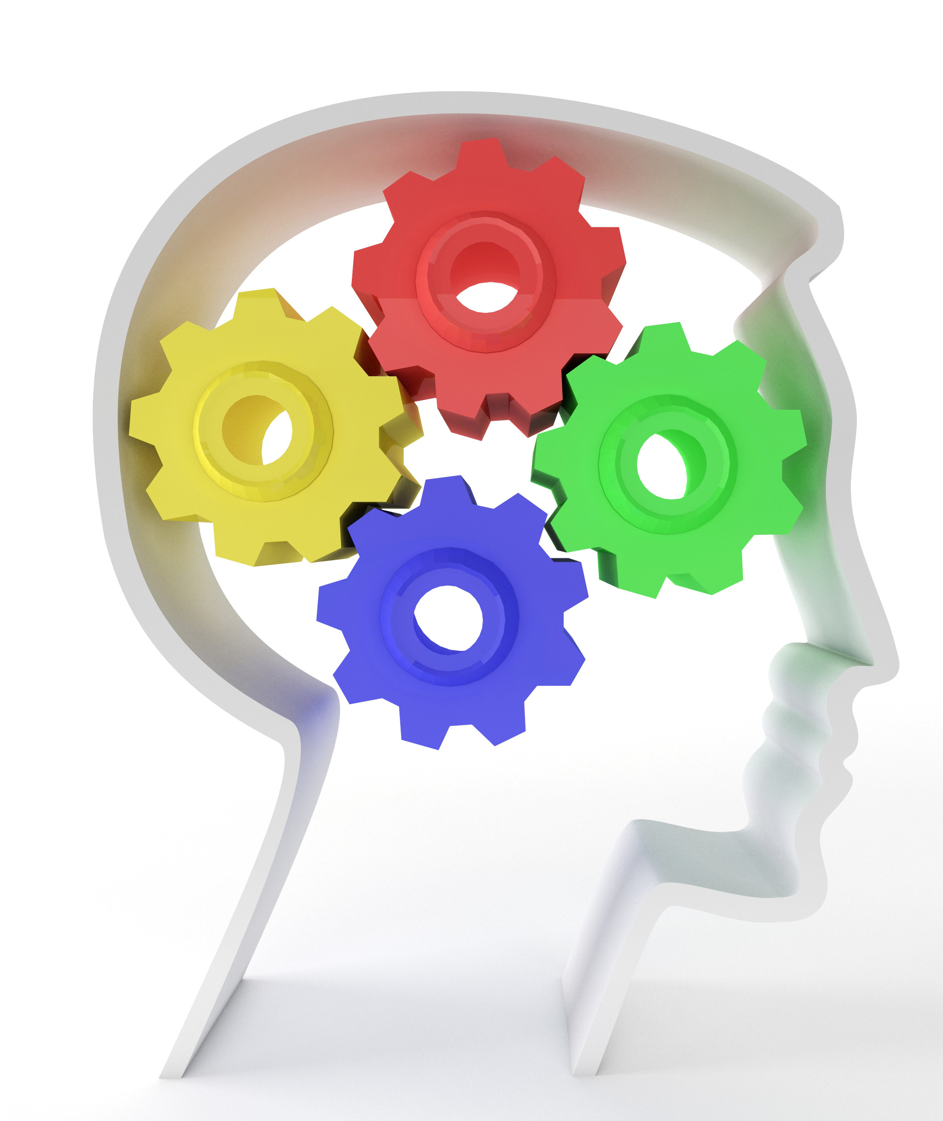
Intrapersonal
Strengths: Introspection and Self-Reflection
Individuals who are strong in intrapersonal intelligence are good at being aware of their own emotional states, feelings and motivations. They tend to enjoy self-reflection and analysis, including day-dreaming, exploring relationships with others and assessing their personal strengths.
Characteristics of Intrapersonal Intelligence
Good at analysing their strengths and weaknesses
Enjoys analysing theories and ideas
Excellent self-awareness
Clearly understands the basis for their own motivations and feelings

Slide 8
Musical
Strengths: Rhythm and Music
People who have strong musical intelligence are good and thinking in patterns, rhythms and sounds. They have a strong appreciation for music and are often good at musical composition and performance.
Characteristics of Musical Intelligence
Enjoy singing and playing musical instruments
Recognizes musical patterns and tones easily
Good at remembering songs and melodies
Rich understanding of musical structure, rhythm and notes

Slide 9
Visual - Spatial
Strengths: Visual and Spatial Judgment
People who are strong in visual-spatial intelligence are good a visualising things. These individuals are often good with directions as well as maps, charts, videos and pictures.
Characteristics of Visual-Spatial Intelligence
Enjoys reading and writing
Good at putting puzzles together
Good at interpreting pictures, graphs and charts
Enjoys drawing, painting and the visual arts
Recognises patterns easily

Slide 10
Naturalistic
Strengths: Finding Patters and Relationships to Nature
Individuals who are high in this type of intelligence are more in tune with nature and are often interested in nurturing, exploring the environment and learning about other species. These individuals are said to be highly aware of even subtle changes to their environments.
Characteristics of Naturalistic Intelligence
Interested in subjects such as botany, biology and zoology
Good at categorizing and cataloging information easily
May enjoy camping, gardening, hiking and exploring the outdoors
Doesn’t enjoy learning unfamiliar topics that have no connection to nature

Slide 11
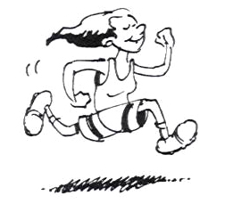
Bodily - Kinesthetic
Strengths: Physical Movement, Motor Control
Those who have high bodily-kinesthetic intelligence are said to be good at body movement, performing actions and physical control. People who are strong in this area tend to have excellent hand-eye coordination and dexterity.
Characteristics of Bodily-Kinesthetic Intelligence
Good at dancing and sports
Enjoy creating things with their hands
Excellent physical coordination
Tends to remember by doing, rather than hearing or seeing

Slide 12
Lets find out our preferred learning styles …
Follow the link to take a quick test which will help us find our preferred learning style:
http://www.bgfl.org/bgfl/custom/resources_ftp/client_ftp/ks3/ict/multiple_int/index.htm
Once you have completed the test save your results and pick out your top 2 learning styles and least preferred learning style
Were you surprised by your results? Why? Why not?

Slide 13
http://psychology.about.com/od/educationalpsychology/ss/multiple-intell.htm

